Slide 1
Ultrasonic Extraction…
MPI Solution for YOU!
January 2020
MP Interconsulting Marais 36, 2400 Le Locle, Switzerland
www.UltrasonicsWorldGroup.com
Phone: +41-32-9314045
Fax: +41-32-9314079
www.mpi-ultrasonics.com
mpi@mpi-ultrasonics.com

Slide 2
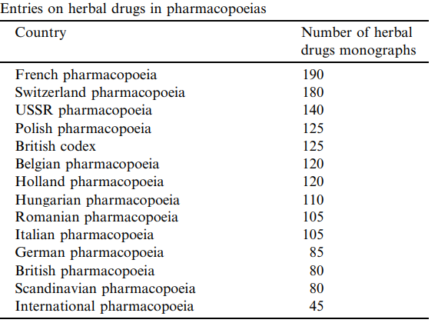
1. The history of extraction:
Vegetal materials are invaluable resources, useful in daily life as food, food activities, flavors, fragrances, pharmaceuticals, colors or directly in medicine.
A herbal extract could be defined as the compounds and/or compound mixtures obtained from fresh or dried plants, or parts of plants: leaves, flowers, seeds, roots and barks.
Medicinal and aromatic plants provide an inexhaustible resource of raw materials for the pharmaceutical, cosmetics and food industries and more recently in agriculture for pest control.
2. Ultrasound assisted extraction (UAE)
Advantages:
Inexpensive, simple and efficient alternative to conventional extraction.
Increase of extraction yield and faster kinetics
Ability to reduce the temperature allowing extraction of thermo sensitive compounds
©2001-16 MP Interconsulting, mpi@mpi-ultrasonics.com

Slide 3
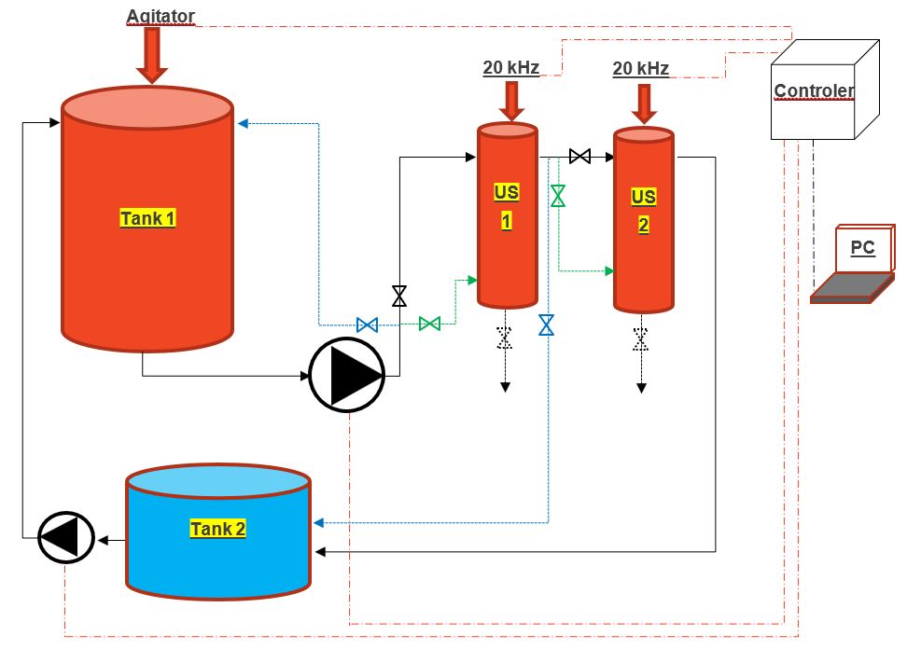
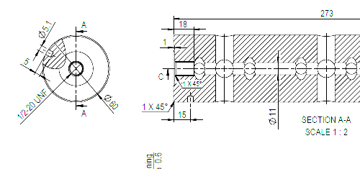
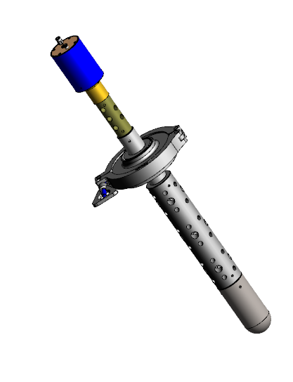
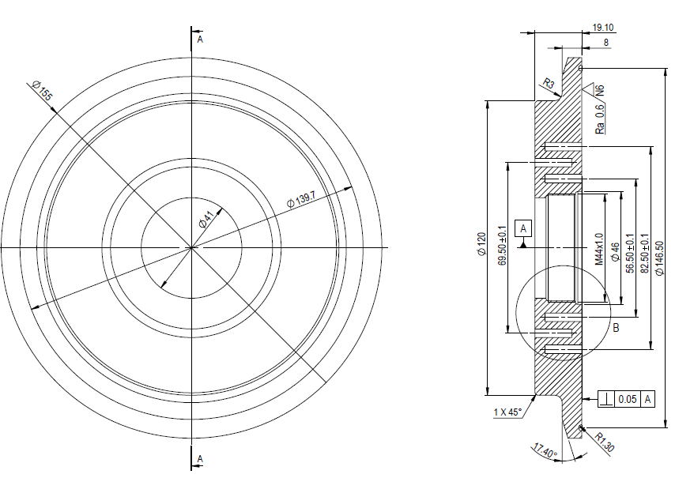
Sonotrodes Optimization – For Continuos Extraction
MPI Poposal, a novel and reliable solution for ingridientes extraction from several plants!
©2001-16 MP Interconsulting, mpi@mpi-ultrasonics.com

Slide 4
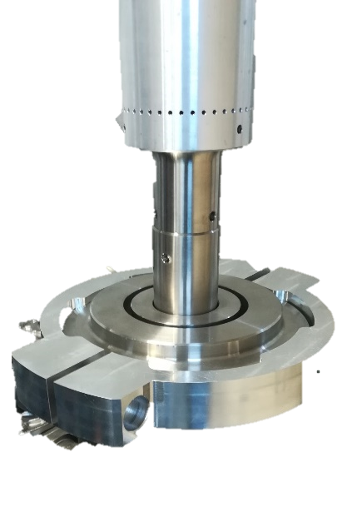
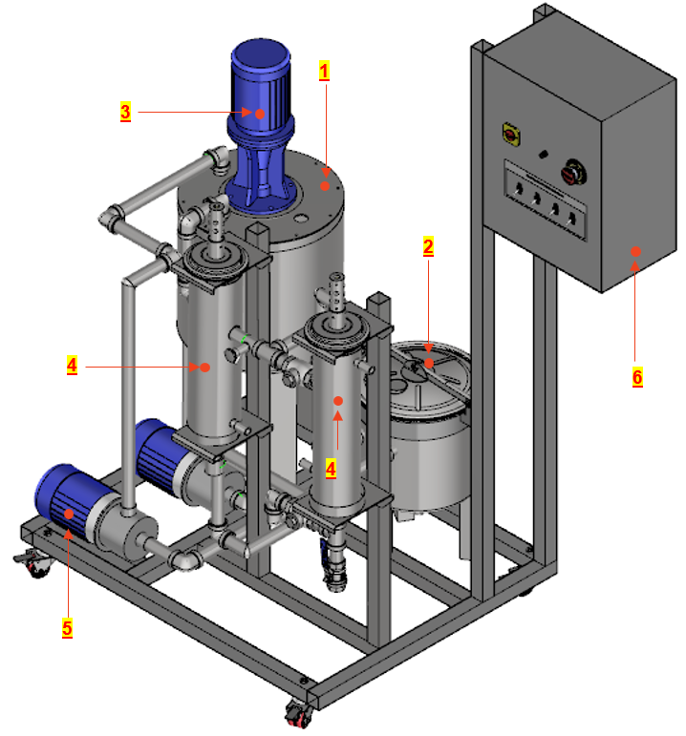
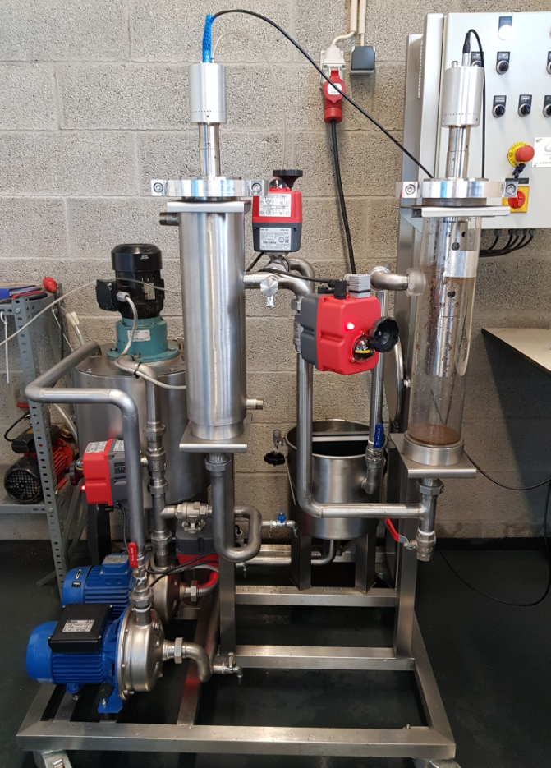
Extraction Capacity 50 L – Continuos
Legend:
|Component (1)| --- Capacity --> 50 liters
|Component (2)| --- Capacity --> 25 liters
|Component (3)| --- Mechanical Agitator
|Component (4)| --- Chamber for Ultrasound Systems
|Component (5)| --- Pumps
|Component (4)| --- Device Control
©2001-16 MP Interconsulting, mpi@mpi-ultrasonics.com

Slide 5
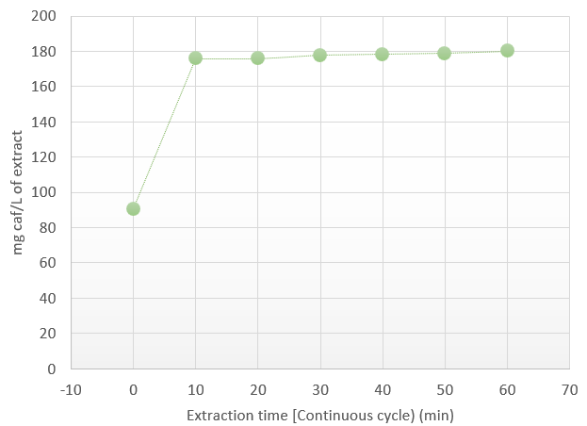
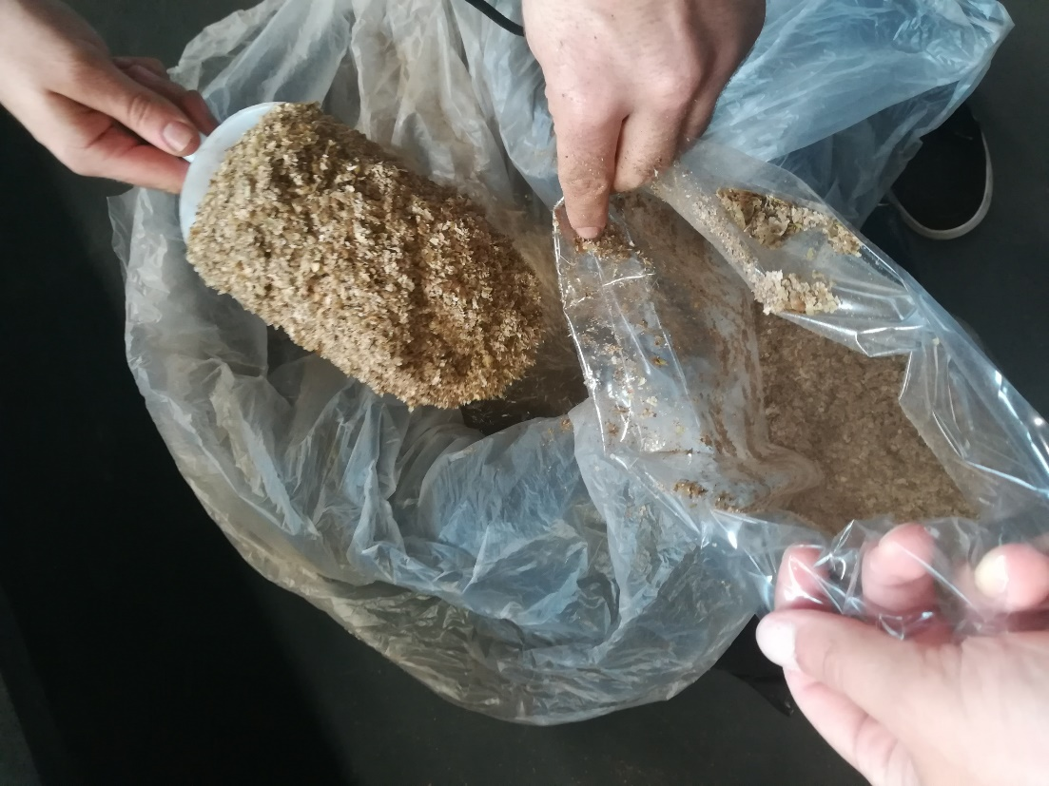
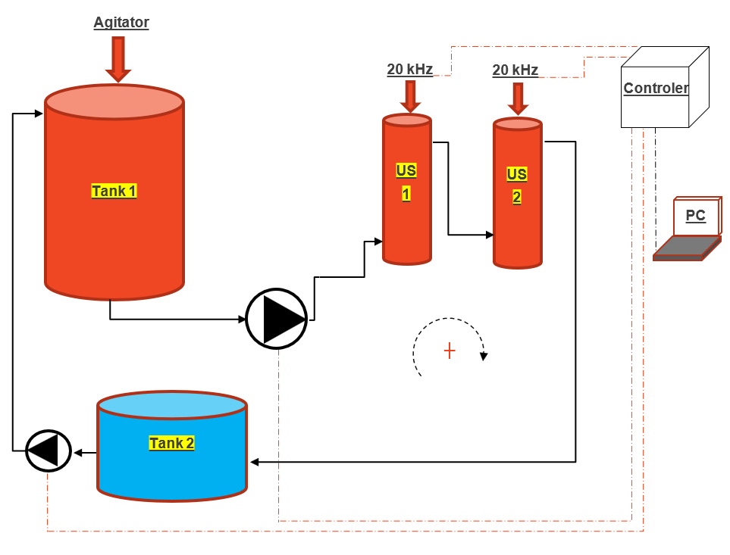
Test 1
Product:
Extract caffeine from coffee beans [silver skin] at low temperature
Study: Evolution of ultrasonic caffeine extraction vs. time.
**
Total Cycle time = 60 minutes
Mixture = > 50 L of water + 1.0 kg of Silver Skin
Samples were collected at each 10 minutes
** mg of caffeine per liter of extract after mechanical mixing
©2001-16 MP Interconsulting, mpi@mpi-ultrasonics.com

Slide 6
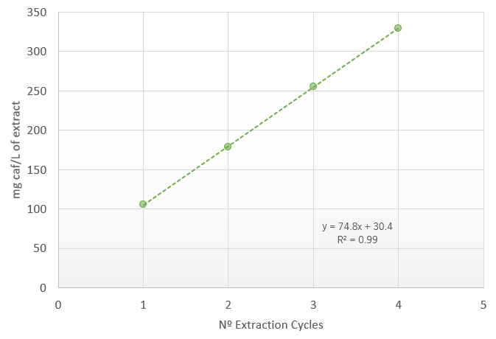
Test 2
Product:
Extract caffeine from coffee beans [silver skin] at low temperature
Study:
Evaluation of maximal saturation of caffeine in the medium.
**
Cycle time = 10 minutes
Time between cycles= 10 minutes
Mixture = > 50 L of water + 2.5 kg of Silver Skin
After each Cycle the waste was removed and new 2.5 kg was added
** mg of caffeine per liter of extract after mechanical mixing
©2001-16 MP Interconsulting, mpi@mpi-ultrasonics.com

Slide 7
Comparative Study
US vs Solvent extraction
Product:
Extract caffeine from coffee beans [silver skin] at low temperature
In this work, we intended to optimize the recovery of caffeine from this by-product, by comparing two different processes of extraction, namely, a classic solid-liquid method, and the physical processing based in MPI ultrasound-assisted technology.
Main Conclusion:
In only 10 min, the sonication probe allowed a higher recovery of caffeine, without any need of sample preparation and using only water as extraction solvent!
©2001-16 MP Interconsulting, mpi@mpi-ultrasonics.com

Slide 8
Thank You.
MP Interconsulting Marais 36, 2400 Le Locle, Switzerland
www.UltrasonicsWorldGroup.com
Phone: +41-32-9314045
Fax: +41-32-9314079
www.mpi-ultrasonics.com
mpi@mpi-ultrasonics.com

